Slide 1
CIS450 / ECE478
Operating Systems
Professor Jinhua Guo
  Some slides and/or pictures are adapted from
  Operating System Concepts, 9th edition, by Silberschatz, Galvin, Gagne, John Wiley & Sons, 2013
  Lecture notes by Dr. Prof. John Kubiatowicz (Berkeley)

Slide 2
Expectations
This class IS about …
  Principles of modern OS’s
    management of processes, memory, files, and I/O devices
  Implementation of several OS features
This class IS NOT about …
  How to use particular OS’s
    Ex. How do I install the Linux on my PC?

Slide 3
What is an Operating System?
It is just a program
Performs two functions
  Make computer system convenient to use
    Example: don’t worry about CPU scheduling
  Manage machine’s resources efficiently
    Example: many users want printer
Convenience and Efficiency conflict

Slide 4

Four Components of a Computer System

Slide 5
Computer System Structure
Hardware – provides basic computing resources
  CPU, memory, I/O devices
Operating system
  Controls and coordinates use of hardware among various applications and users
Application programs – define the ways in which the system resources are used to solve the computing problems of the users
  Word processors, compilers, web browsers, database systems, video games
Users
  People, machines, other computers

Slide 6

Computer System Organization
Computer-system operation
  One or more CPUs, device controllers connect through common bus providing access to shared memory
  Concurrent execution of CPUs and devices competing for memory cycles

Slide 7
Computer-System Operation
I/O devices and the CPU can execute concurrently
Each device controller is in charge of a particular device type
Each device controller has a local buffer
CPU moves data from/to main memory to/from local buffers
I/O is from the device to local buffer of controller
Device controller informs CPU that it has finished its operation by causing an interrupt

Slide 8
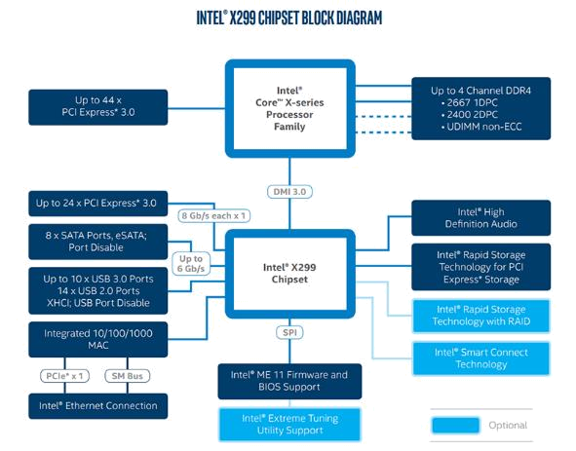
HW Functionality comes with great complexity!
Intel Skylake-X
I/O Configuration
Proc
Caches
Busses
adapters
Memory
Controllers
I/O Devices:
Disks
Displays
Keyboards
Networks

Slide 9
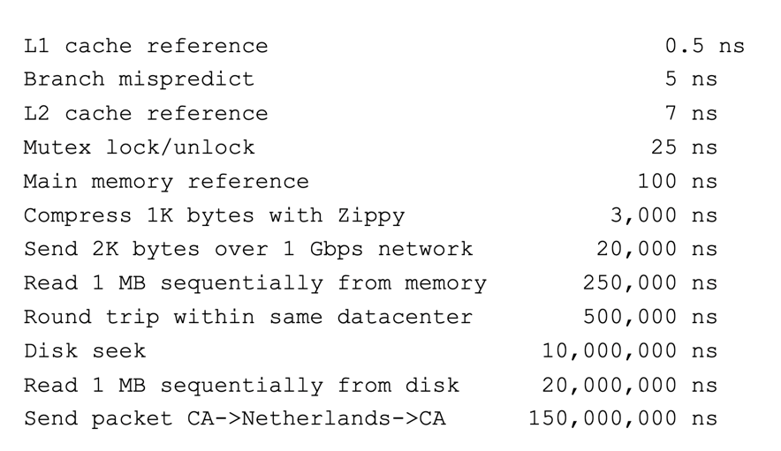
And Range of Timescales

Slide 10
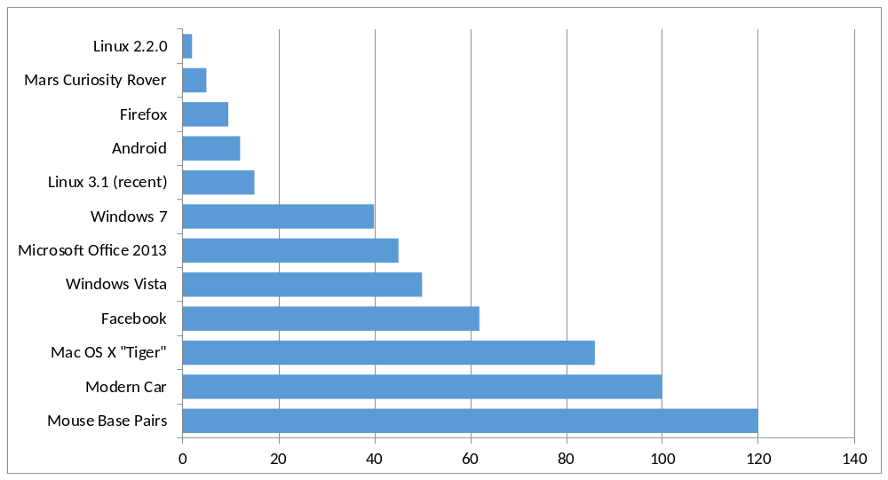
Increasing Software Complexity
Millions of Lines of Code
(source https://informationisbeautiful.net/visualizations/million-lines-of-code/)

Slide 11
How do we tame complexity?
Every piece of computer hardware different
  Different CPU
    x86, PowerPC, ColdFire, ARM, MIPS
  Different amounts of memory, disk, …
  Different types of devices
    Mice, Keyboards, Sensors, Cameras, Fingerprint readers
  Different networking environment
    Cable, DSL, Wireless, Firewalls,…
Questions:
  Does a programmer need to write a single program that performs many independent activities?
  Does every program have to be altered for every piece of hardware?
  Does a faulty program crash everything?
  Does every program have access to all hardware?

Slide 12
OS Abstracts the Underlying Hardware
Processor → Thread
Memory → Address Space
Disks, SSDs, … → Files
Networks → Sockets
Machines → Processes
OS as an Illusionist:
  Remove software/hardware quirks (fight complexity)
  Optimize for convenience, utilization, reliability, … (help the programmer)
For any OS area (e.g. file systems, virtual memory, networking, scheduling):
  What hardware interface to handle? (physical reality)
  What’s software interface to provide? (nicer abstraction)
Application
Operating System
Hardware
Abstract Machine Interface
Physical Machine Interface

Slide 13
What does an Operating System do?
Silberschatz and Gavin: “An OS is Similar to a government”
  Protect users from each other
  Allocate resources efficiently and fairly
Coordinator and Traffic Cop:
  Manages all resources
  Settles conflicting requests for resources
  Prevent errors and improper use of the computer
Facilitator:
  Provides facilities that everyone needs
  Standard Libraries, Windowing systems
  Make application programming easier, faster, less error-prone
Some features reflect both tasks:
  E.g. File system is needed by everyone (Facilitator)
  But File system must be Protected (Traffic Cop)

Slide 14
What is an Operating System
Most Likely:
  Memory Management
  I/O Management
  CPU Scheduling
  Communications
  Multitasking/multiprogramming
What about?
  File System?
  Multimedia Support?
  User Interface?
  Internet Browser?

Slide 15
Operating System Definition (Cont.)
No universally accepted definition
“Everything a vendor ships when you order an operating system” is good approximation
  But varies wildly
“The one program running at all times on the computer” is the kernel.
  Everything else is either a system program (ships with the operating system) or an application program

Slide 16
Example: Protecting Processes from Each Other
Problem: Run multiple applications in such a way that they are protected from one another
Goal:
  Keep User Programs from Crashing OS
  Keep User Programs from Crashing each other
Simple Policy:
  Programs are not allowed to read/write memory of other Programs or of Operating System
Mechanisms:
  Address Translation
  Dual Mode Operation

Slide 17
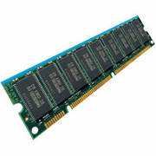
Address Translation
Address Space
  A group of memory addresses usable by something
  Each program (process) and kernel has potentially different address spaces.
Address Translation:
  Translate from Virtual Addresses (emitted by CPU) into Physical Addresses (of memory)
  Mapping often performed in Hardware by Memory Management Unit (MMU)
Virtual
Addresses
Physical
Addresses
CPU
MMU

Slide 18
Example of Address Translation
Code
Data
Heap
Stack
Data 2
Code
Data
Heap
Stack
Stack 1
Heap 1
Code 1
Stack 2
Prog 1
Virtual
Address
Space 1
Data 1
Prog 2
Virtual
Address
Space 2
Heap 2
Code 2
OS code
Translation Map 1
OS data
Translation Map 2
OS heap &
Stacks
Physical Address Space

Slide 19

Dual Mode Operation
Hardware provides at least two modes:
  “Kernel” mode (or “supervisor” or “protected”)
  “User” mode: Normal programs executed
Some instructions/ops prohibited in user mode:
  Example: cannot modify page tables in user mode
    Attempt to modify ⇒ Exception generated
Transitions from user mode to kernel mode:
  System Calls, Interrupts, Other exceptions

Slide 20

UNIX System Structure
Applications
User Mode
Standard Libs
Kernel Mode
Hardware

Slide 21

System Calls (What is the API)

Slide 22
User/Kernel (Privileged) Mode
User Mode
interrupt
exception
syscall
rtn
rfi
Kernel Mode
exit
exec
Limited HW access
Full HW access

Slide 23
3 types of Mode Transfer
Syscall
  Process requests a system service, e.g., exit
  Like a function call, but “outside” the process
  Does not have the address of the system function to call
  Like a Remote Procedure Call (RPC) – for later
  Marshall the syscall id and args in registers and exec syscall
Interrupt
  External asynchronous event triggers context switch
  e. g., Timer, I/O device
  Independent of user process
Trap or Exception
  Internal synchronous event in process triggers context switch
  e.g., Protection violation (segmentation fault), Divide by zero, …
All 3 are an UNPROGRAMMED CONTROL TRANSFER
  Where does it go?

Slide 24
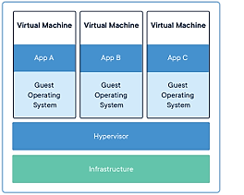
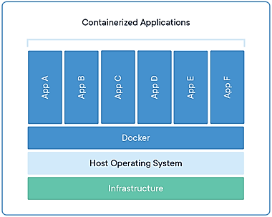
Virtualization: Execution Environments for Systems
Additional layers of protection and isolation can help further manage complexity

Slide 25
History Phase 1 (1948—1970)
Hardware Expensive, Humans Cheap
When computers cost millions of $’s, optimize for more efficient use of the hardware!
  Lack of interaction between user and computer
User at console: one user at a time
Batch monitor: load program, run, print
Optimize to better use hardware
  When user thinking at console, computer idle⇒BAD!
  Feed computer batches and make users wait
No protection: what if batch program has bug?
Notes:
OS first appeared as a subroutine “library” shared by all users. Library: pull card decks from wall.

Slide 26
History Phase 1½ (late 60s/early 70s)
Data channels, Interrupts: overlap I/O and compute
  DMA – Direct Memory Access for I/O devices
  I/O can be completed asynchronously
Multiprogramming: several programs run simultaneously
  Small jobs not delayed by large jobs
  More overlap between I/O and CPU
  Need memory protection between programs and/or OS
Complexity gets out of hand:
  Multics: announced in 1963, ran in 1969
    1777 people “contributed to Multics” (30-40 core dev)
    Turing award lecture from Fernando Corbató (key researcher): “On building systems that will fail”
  OS 360: released with 1000 known bugs (APARs)
    “Anomalous Program Activity Report”
OS finally becomes an important science:
  How to deal with complexity???
  UNIX based on Multics, but vastly simplified
Notes:
Multiprogramming: 2 jobs (1 takes 10 hrs, the other 10 mins). Don’t have to wait 10 hrs!
www.multicians.org lists 1777 people who “contributed to Multics”. Probably 30-40 core developers.

Slide 27
History Phase 2 (1970 – 1985)
Hardware Cheaper, Humans Expensive
Computers available for tens of thousands of dollars instead of millions
OS Technology maturing/stabilizing
Interactive timesharing:
  Use cheap terminals (~$1000) to let multiple users interact with the system at the same time
  Sacrifice CPU time to get better response time
  Users do debugging, editing, and email online
Problem: Thrashing
  Performance vary non-linear
  response with load
  Thrashing caused by many
  factors including
    Swapping, queueing
Response
time
Users
Notes:
Computers are friendly things: 1 terminal, feed me. Add another terminal, feed me. Can you keep doing this? NO!
Eventually fall off a cliff (add one more user, computer slows down by a factor of 1000)

Slide 28
History Phase 3 (1981— )
Hardware Very Cheap, Humans Very Expensive
Computer costs $1K, Programmer costs $100K/year
  If you can make someone 1% more efficient by giving them a computer, it’s worth it!
  Use computers to make people more efficient
Personal computing:
  Computers cheap, so give everyone a PC
Limited Hardware Resources Initially:
  OS becomes a subroutine library
  One application at a time (MSDOS, CP/M, …)
Eventually PCs become powerful:
  OS regains all the complexity of a “big” OS
  multiprogramming, memory protection, etc (NT,OS/2)
Notes:
No, Feature creep. PC made OS a subroutine all over again. But then realized even single users need memory protection, multiprogramming, etc. Same is true of PDAs and phones

Slide 29
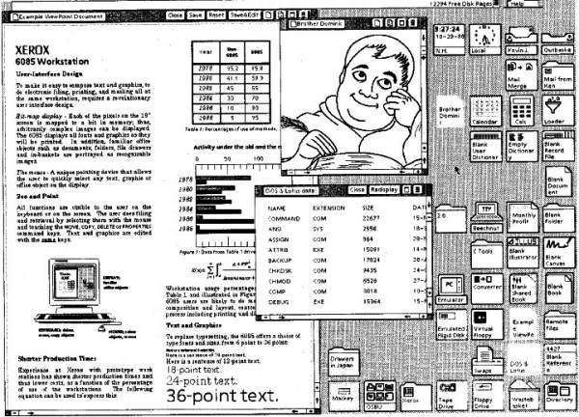
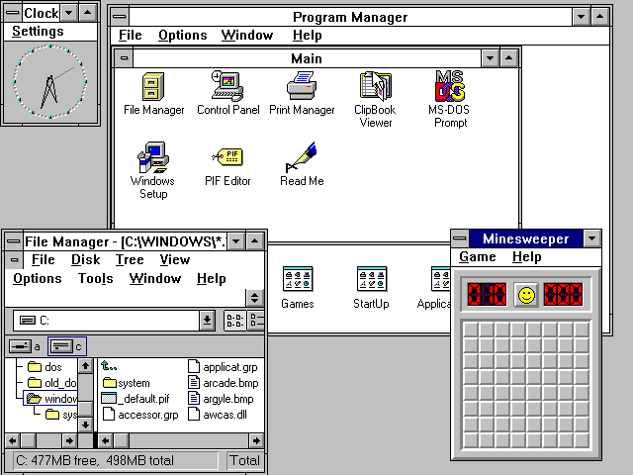
History Phase 3 (con’t)
Graphical User Interfaces
Xerox Star: 1981
  Originally a research
  project (Alto)
  First “mice”, “windows”
Apple Lisa/Machintosh: 1984
  “Look and Feel” suit 1988
Microsoft Windows:
  Win 1.0 (1985)
  Win 3.1 (1990)
  Win 95 (1995)
  Win NT (1993)
  Win 2000 (2000)
  Win XP (2001)
  Win Vista (2007)
  Win 7 (2009)
  Win 8 (2012)
Xerox Star
Single
Level
HAL/Protection
No HAL/
Full Prot
Windows 3.1

Slide 30

History Phase 4 (1988—): Distributed Systems
Networking (Local Area Networking)
  Different machines share resources
  Printers, File Servers, Web Servers
  Client – Server Model
Services
  Computing
  File Storage
Notes:
Why do we need distributed systems? Resource sharing (printers, Internet connections,…) and info sharing (files, email, IM, …)

Slide 31
History Phase 4 (1988—): Internet
Developed by the research community
  Based on open standard: Internet Protocol
  Internet Engineering Task Force (IETF)
Technical basis for many other types of networks
  Intranet: enterprise IP network
Services Provided by the Internet
  Shared access to computing resources: telnet (1970’s)
  Shared access to data/files: FTP, NFS, AFS (1980’s)
  Communication medium over which people interact
    email (1980’s), on-line chat rooms, instant messaging (1990’s)
    audio, video (1990’s, early 00’s)
  Medium for information dissemination
    USENET (1980’s)
    WWW (1990’s)
    Audio, video (late 90’s, early 00’s) – replacing phone, TV?
    File sharing (late 90’s, early 00’s)

Slide 32
History Phase 5 (1995—): Mobile Systems
Ubiquitous Mobile Devices
  Laptops, PDAs, phones
  Small, portable, and inexpensive
    Recently twice as many smart phones as PDAs
    Many computers/person!
  Limited capabilities (memory, CPU, power, etc…)
Wireless/Wide Area Networking
  Leveraging the infrastructure
  Huge distributed pool of resources extend devices
  Traditional computers split into pieces. Wireless keyboards/mice, CPU distributed, storage remote
Peer-to-peer systems
  Many devices with equal responsibilities work together
  Components of “Operating System” spread across globe

Slide 33
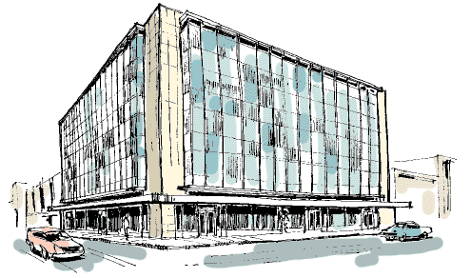
Datacenter is the Computer
Google program == Web search, Gmail,…
Google computer ==
  Hundreds of thousands of computers, networking, storage
Warehouse-sized facilities and workloads

Slide 34
OS Archaeology
Because of the cost of developing an OS from scratch, most modern OSes have a long lineage:
Multics → AT&T Unix → BSD Unix → Ultrix, SunOS, NetBSD,…
Mach (micro-kernel) + BSD → NextStep → XNU →
Apple OS X, iPhone iOS
MINIX → Linux → Android OS, Chrome OS, RedHat, Ubuntu, Fedora, Debian, Suse,…
CP/M → QDOS → MS-DOS → Windows 3.1 → NT → 95 → 98 → 2000 → XP → Vista → 7 → 8 → 10 → …
Notes:
Multics: MIT, GE, Bell Labs, 1969
Revolutionary but “bloated” at 135kB
Famous “failures”: Multics, Mach, NextStep: innovative but too flawed to succeed.
Microsoft established itself by writing an OS to compete with CP/M which IBM couldn’t negotiate with its author. They instead bought QDOS from a small code author who had written it from the CP/M manual.
Interestingly, there were some other OSes that didn’t have such a long lineage (e.g. IBM OS/2)

Slide 35

Migration of Operating-System Concepts and Features

Slide 36
History of OS: Summary
Change is continuous and OSs should adapt
  Not: look how stupid batch processing was
  But: Made sense at the time
Situation today is much like the late 60s
  Small OS: 100K lines
  Large OS: 10M lines (5M for the browser!)
    100-1000 people-years
Complexity still reigns
  NT developed (early to late 90’s): Never worked well
  Windows 2000/XP: Very successful
  Windows Vista (aka “Longhorn”) delayed many times
    Finally released in January 2007
  Windows 10 (2015 to today) as an "operating system as a service"
Notes:
How many people have written a 1K program? 15 pages
How many people have written a 10K program? 150 pages

Slide 37
Operating Systems Components
(What are the pieces of the OS)
Process Management
Main-Memory Management
I/O System management
File Management
Networking
User Interfaces

Slide 38
Operating System Services
(What things does the OS do?)
Services that (more-or-less) map onto components
  Program execution
    How do you execute concurrent sequences of instructions?
  I/O operations
    Standardized interfaces to extremely diverse devices
  File system manipulation
    How do you read/write/preserve files?
    Looming concern: How do you even find files???
  Communications
    Networking protocols/Interface with CyberSpace?
Cross-cutting capabilities
  Error detection & recovery
  Resource allocation
  Accounting
  Protection

Slide 39
Implementation Issues
(How is the OS implemented?)
Policy vs. Mechanism
  Policy: What do you want to do?
  Mechanism: How are you going to do it?
  Should be separated, since both change
Algorithms used
  Linear, Tree-based, Log Structured, etc…
Event models used
  threads vs event loops
Backward compatibility issues
System generation/configuration
  How to make generic OS fit on specific hardware

Slide 40
OS Systems Principles
OS as illusionist:
  Make hardware limitations go away
  Provide illusion of dedicated machine with infinite memory and infinite processors
OS as government:
  Protect users from each other
  Allocate resources efficiently and fairly
OS as complex system:
  Constant tension between simplicity and functionality or performance
OS as history teacher
  Learn from past
  Adapt as hardware tradeoffs change

Slide 41
OS Summary
Operating systems provide a virtual machine abstraction to handle diverse hardware
Operating systems coordinate resources and protect users from each other
Operating systems simplify application development by providing standard services
Operating systems can provide an array of fault containment, fault tolerance, and fault recovery
CIS 450 /ECE478 combines things from many other areas of computer science –
  Languages, data structures, hardware, and algorithms

Slide 42
Conclusions
Rapid Change in Hardware Leads to changing OS
  Batch ⇒ Multiprogramming ⇒ Timeshare ⇒ Graphical UI ⇒ Ubiquitous Devices ⇒ Cyberspace/Metaverse/??
OS features migrated from mainframes ⇒ PCs
Standard Components and Services
  Process Control
  Main Memory
  I/O
  File System
  UI
Policy vs Mechanism
  Crucial division: not always properly separated!
Complexity is always out of control
  However, “Resistance is NOT Useless!”

